Slide 1
ISSF CHAMPIONSHIP
ORGANIZERS WORKSHOP
Sustainability
MUNICH 2023
Notes:
1

Slide 2
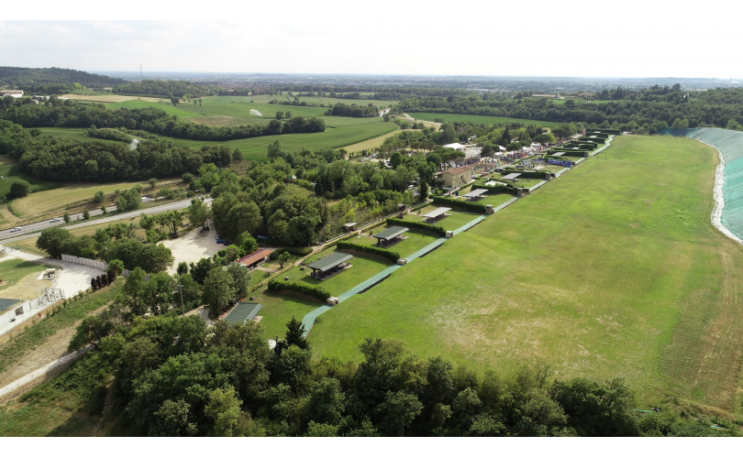
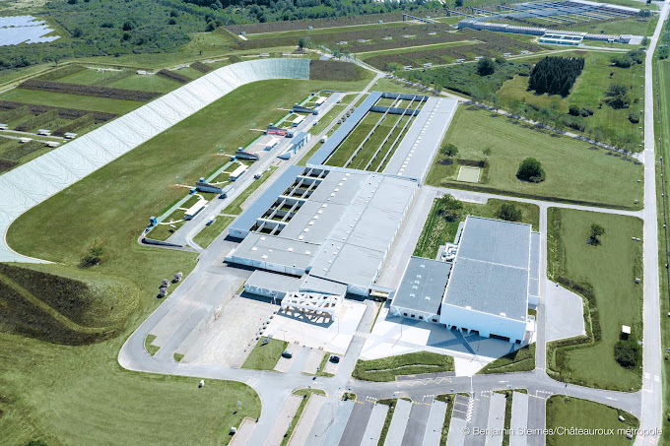
WORKSHOP
MUNICH 2023
ISSF’s Sustainability Strategy
So much more than just environment
ISSF CHAMPIONSHIP ORGANIZERS WORKSHOP - Sustainability
Munich, Ger 02 - 07 DEC 2023
Notes:
Hello and thank you for attending this workshop
The ISSF Sustainablity Committee (of which I am Chair) has been focused on the Proposed ban of the use of LEAD in small arms ammunition across Europe and we have been urging all the European countries to be active on that file. Sweden Finland and some other EU countries have proposed a 10 year moratorium on the ban and I hope you will encourage your politicians to support that.
If you want to know more about these issues please see the ISSF webpage on Environmental Protection
Todays presentation is going to focus on what the ISSF should be doing as an international Sport Organization in the International Olympic Committee. We are behind most other sports and have a vested interest to get caught up and become a leader in supporting the Sustainable Development Goals of the United Nations and the IOC’s goals.

Slide 3
WORKSHOP
MUNICH 2023
For your Awareness: LEAD Ammunition
ECHA is proposing that all lead gun shot be banned within 5 years with some exceptions
Greatest immediate impact will be the feasibility of ranges that have not been designed to easily contain and recover spent lead (shotgun and outdoor rifle/pistol)
Long term impact will be unacceptable.
ISSF is actively proposing a lead containment and economically viable recycling approach based on Best Available Technologies (BAT).
It is very important that ISSF member federations voluntarily move towards BAT in all of their ranges.
ISSF Sustainability committee will be providing membership with BAT references in 2024
ISSF CHAMPIONSHIP ORGANIZERS WORKSHOP - Sustainability
Munich, Ger 02 - 07 DEC 2023
Notes:
3including
use indoors
Outdoor target ranges can use lead where 90% of the lead is recovered annually
Currently being considered at the highest level of the European Commission
Some EU countries are actively requesting a 10 year moratorium on the decision

Slide 4
WORKSHOP
MUNICH 2023
The Int. Olympic Committee’s Sustainability Strategy
“when making decisions, we ensure feasibility and we seek to maximize positive impact and minimize negative impact in the social economic and environmental spheres” (IOC 2016,2017)
Agenda 2020 +5 had 2 recommendations worth noting
Include Sustainability in all aspects of the Olympic Games
Olympic Organizers integrate and implement Sustainability measures that encompass economic social and environmental spheres
Best possible Governance
Monitor the Games Legacy
Include sustainability within the Olympics Movements Daily Operations
Provide Tools (best practices and scorecards)
Share knowledge between Stakeholders
etc
ISSF CHAMPIONSHIP ORGANIZERS WORKSHOP - Sustainability
Munich, Ger 02 - 07 DEC 2023
Notes:
The key words are SOCIAL ECONOMIC and ENVIRONMENTAL
ISSF has been expected to be doing work in this area since 2016.
This does not mean saying we are doing something but PROVING IT

Slide 5
World Rugby Carbon Footprint/Circular Economy , Protecting Nature
Int. Biathlon Supporting reforestation, spread awareness, cumulative impact
Sailing, Tennis Biathlon, Cycling – Recycling carbon fibers used in sport
Floorball promote inclusiveness, reducing carbon footprint with stick manufacturers
Athletics social responsibility, healthy society, eco-effective competition guidelines, social equality
Spain, Australia, Czech, Hungary, Slovakia, Denmark, Finland, Germany NOC’s adopting requirements and guidelines
There are many more……….
ISSF CHAMPIONSHIP ORGANIZERS WORKSHOP - Sustainability
Notes:
There are more case studies than this slide shows…many more
Additionally many of your NOC’s have made the move to create guidelines and requirements so your National Sport organization would be well served to keep working towards the goals

Slide 6
WORKSHOP
MUNICH 2023
Text
Text
ISSF CHAMPIONSHIP ORGANIZERS WORKSHOP - Sustainability
Munich, Ger 02 - 07 DEC 2023
Notes:
3

Slide 7
WORKSHOP
MUNICH 2023
KEY STEPS for ISSF
Assess where we are
Define where we want to go (Vision)
Lead by example
Govern with the vision in mind
Engage stakeholders
Identify key issues and scope
Set objectives and targets
Assess progress
Report and communicate and further educate
ISSF CHAMPIONSHIP ORGANIZERS WORKSHOP - Sustainability
Munich, Ger 02 - 07 DEC 2023
Notes:
3

Slide 8
WORKSHOP
MUNICH 2023
ISSF and ISSF Event Organizers
MEASURE, DOCUMENT, REDUCE, MEASURE, DOCUMENT IMPROVEMENT
SDG 3. Good Health and Wellbeing
Safety rules (shotgun pointing)
Smoking rule enforcement
Food choices at events (food safety and quality)
SDG 5. Gender Equality
Continue fairness between men’s and women’s events
Encourage more female coaches and referees
Require equality action of all confederations
Employee wage equivalence
SDG 7. Clean Energy
Energy sources and efficiencies at offices,range and for transportation
Require use of mass transportation and less frequencies
ISSF CHAMPIONSHIP ORGANIZERS WORKSHOP - Sustainability
Munich, Ger 02 - 07 DEC 2023
Notes:
3

Slide 9
WORKSHOP
MUNICH 2023
ISSF and ISSF event Organizing Committees
MEASURE, DOCUMENT, REDUCE, MEASURE, DOCUMENT IMPROVEMENT
SDG 8. Decent Work and Economic Growth
Employee Occupational safety
Employment and economics in rural areas
SDG10. Reduced Inequalities
Para events combined with regular events ? Mixed teams
Employee and Volunteer gender ratio and policies
SDG13. Climate Action
Reduced Plastic use/recycling (food packaging, water bottles, shotgun hulls, wads)
Reducing Carbon Footprint - scheduling events, transportation,
Paper reduction – electronic targets, paperless events
Reduced Travel -Increased continental vs World event
ISSF CHAMPIONSHIP ORGANIZERS WORKSHOP- Sustainability
Munich, Ger 02 - 07 DEC 2023
Notes:
3

Slide 10
WORKSHOP
MUNICH 2023
ISSF and ISSF event Organizing Committees
MEASURE, DOCUMENT, REDUCE, MEASURE, DOCUMENT IMPROVEMENT
SDG14. Life below water
No shooting over wetlands or waterbodies
Water runoff monitored
SDG15. Life on Land
No shooting over Agricultural Crops
Clay target type
Lead containment & recycling
Reduction of landfill wastes
Use of full transportation systems (buses)
SDG16. Peace Justice and Strong Institutions
Confederation constitutions and governance audits
Sustainability considered in all decision making
ISSF CHAMPIONSHIP ORGANIZERS WORKSHOP- Sustainability
Munich, Ger 02 - 07 DEC 2023
Notes:
3

Slide 11
WORKSHOP
MUNICH 2023
The ISSF Sustainability committee
S.C. is in the process of developing a list of items to be measured at 2024 World Cup events. Types of data required will be
Transportation methods of athletes Carpool, train, Plane | Amount of equipment transported
Accommodation | Volume of Ammunition purchased on site
Meal types and meals sold on site | Water sourcing and amount sold
Number of shots taken (practice and competition) | Facility conditions (Risk assessed, Employee safety practices etc)
Recyclable materials collected | Plastic controls and recycling
Lead controls and recycling | Employee /volunteer gender numbers
And more
ISSF CHAMPIONSHIP ORGANIZERS WORKSHOP - Sustainability
Munich, Ger 02 - 07 DEC 2023
Notes:
Expect a zoom call in early January to provide understanding of the data needed.

Slide 12
WORKSHOP
MUNICH 2023
Increasing Awareness of our Sustainability activities
Enforce the rules and guidelines we have
Justify bus schedules/ reduced availability or increased cost of parking,
Reward good behaviors, (celebrate returning recyclables, hull recycling etc)
Take action and brag about it
ISSF CHAMPIONSHIP ORGANIZERS WORKSHOP - Sustainability
Munich, Ger 02 - 07 DEC 2023
Notes:
3

Slide 13
WORKSHOP
MUNICH 2023
ISSF leadership actions in 2024
Ensuring World Cup / Continental events scheduling 2025 and beyond embrace Sustainability Goals
Requiring event bids to have Sustainability actions outlined
Improving the relationship with recycling industry and our sport equipment manufacturing industry.
Looking to alternatives for plastics, and disposables used
Develop educational materials and support actions by athletes, Continental Confederations and National Sport Organizations
Reward the efforts of Sustainability leaders
ISSF CHAMPIONSHIP ORGANIZERS WORKSHOP - Sustainability
Munich, Ger 02 - 07 DEC 2023
Notes:
3

Slide 14
WORKSHOP
MUNICH 2023
Take Away Messages
Sustainability is more than Greenhouse gases and environment
ISSF is lagging behind other sports and should use others’ work as a springboard to action.
ISSF needs to prove it is taking Sustainability goals seriously and draw attention to what we do.
2024 Event Organizers will be expected to capture a list of information to ensure data can be collected for 2024 baseline.
ISSF CHAMPIONSHIP ORGANIZERS WORKSHOP - Sustainability
Munich, Ger 02 - 07 DEC 2023
Notes:
3

Slide 15
Questions ???
ISSF CHAMPIONSHIP
ORGANIZERS WORKSHOP
Sustainability
MUNICH 2023
Notes:
1

